Slide 1
Machine Learning
Lesson 10: Text Mining

Slide 2

By the end of this lesson, you will be able to:
Explain text mining
Execute text processing tasks

Slide 3
NLTK corpora
Text Extraction and Pre-processing
Structuring Sentences

Slide 4
Text Mining
Topic 1: Overview

Slide 5
Definition
Interpretation or
Evaluation
Data Mining or
Pattern Discovery
Attribute Selection
Text Transformation
Attribute Generation
Text Preprocessing
Text
Text mining utilizes computational techniques to extract and summarize high-quality information from unstructured textual resources.
Notes:
Trainer Notes:
1. Explain the various stages involved in Text mining

Slide 6



Significance
DOCUMENT CLUSTERING
01
Product INSIGHTS
Clustering makes it easy to
group similar documents into meaningful groups.
News sections are often grouped as business, sports, politics
Mining consumer reviews can reveal insights like most loved feature, most hated feature, improvements required, reviews of competitors’ products
04
02
PaTTERN IDENTIFICATION
security MONITORING
Features such as telephone numbers, e-mail addresses
can be extracted using
pattern matches
03
Text mining helps in monitoring and extracting information from news articles and reports for national security purposes

Slide 7




Applications
SPEECH RECOGNITION
Recognition and translation of
spoken language into text and
vice - versa
SPAM FILTERING
Automatic detection of spam mail
SENTIMENT ANALYSIS
Determining if a given sentence
expresses positive, neutral, or
negative sentiment
E-commerce Personalization
Suggest products that fit into a
user’s profile
Notes:
Trainer Notes:
1. Give few other real time examples

Slide 8
Text Mining
Topic 2: NLTK Library

Slide 9

Significance
01
NLTK is a set of open source Python modules used to
work with human language data for applying statistical
natural language processing (NLP)
02
Natural Language Toolkit (NLTK)
Provides easy-to-use interfaces to over 50 corpora and
lexical resources such as WordNet
03
Provides text processing libraries for classification,
tokenization, stemming, tagging, parsing, and semantic reasoning
Notes:
Trainer Notes:
1. Explain NLTK significance

Slide 10
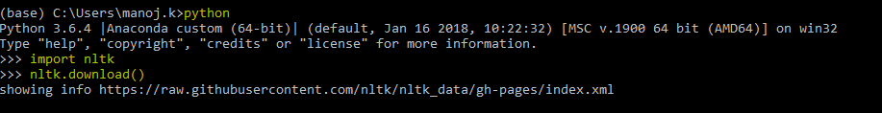
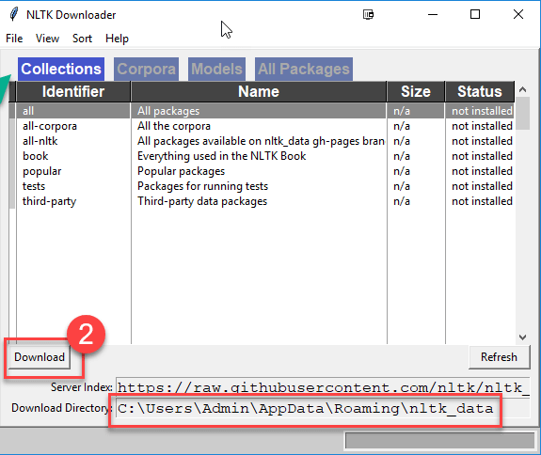
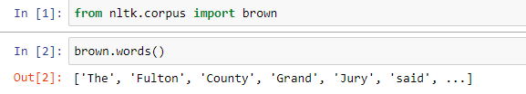
Environment Setup
Step 1) Launch python interpreter from anaconda prompt and enter the highlighted commands
Step 2) NLTK downloaded window opens,
select all packages and click on download
Step 3) Test the setup using the below commands
Notes:
Trainer Notes:
1. Ask learners to install the nltk package

Slide 11
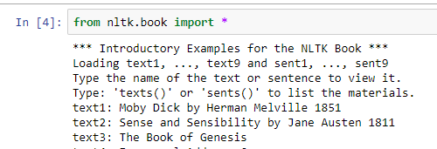
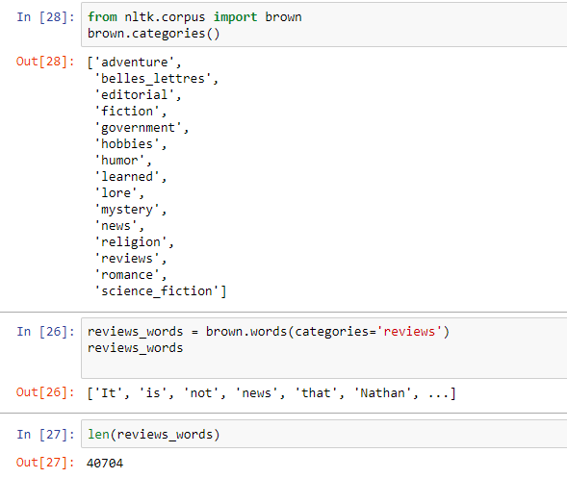
Reading NLTK corpora
Loading all items from NLTK's book module
Exploring brown corpus
Notes:
Trainer Notes:
1. Demo reading and exploring a sample corpus in Jupyter

Slide 12
Text Mining
Topic 3: Text Extraction and Pre-processing

Slide 13
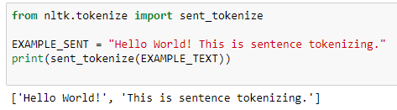
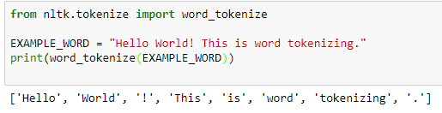
Tokenization
Tokenization is a process of breaking running stream of text into words and sentences.
It works by separating words using spaces and punctuation.
Tokenization
Sentences
Words
Notes:
Trainer Notes:
1. Demo Tokenization in Jupyter

Slide 14
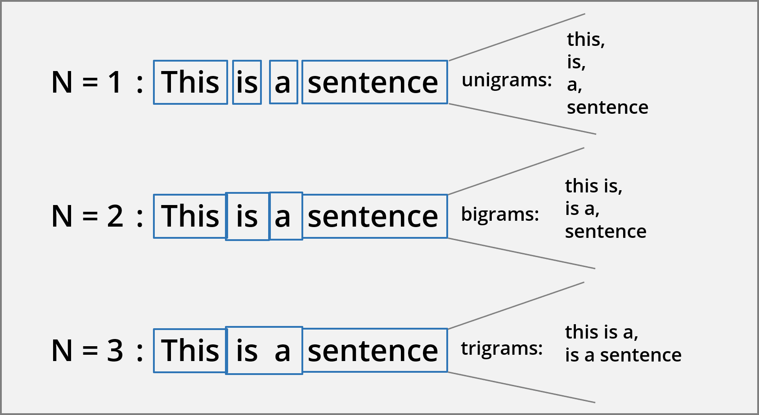
N - grams
N-grams are combinations of adjacent words or letters of length n in the source text.
Notes:
Trainer Notes:
1. Explain the need to use N-grams

Slide 15
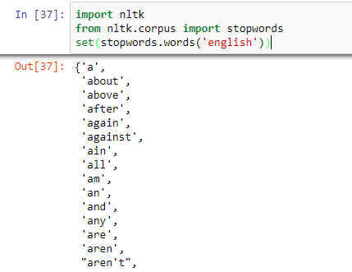
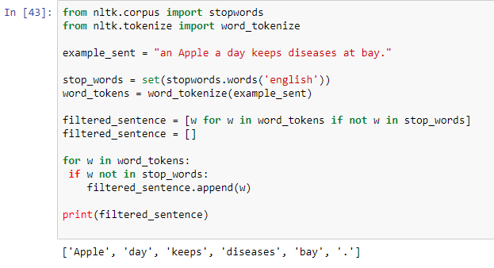
Stop Word Removal
1) Stop words are natural language words which have very little meaning, such as “a", “an", "and", “the", and similar words.
These are filtered out before processing of natural language
data as they don’t reveal much information.
i
Stop words are language dependent
Notes:
Trainer Notes:
1. Demo Stop Word removal in Jupyter

Slide 16
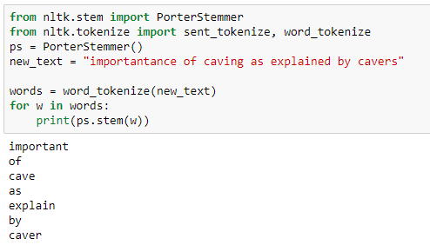
Stemming
Stemming involves reducing a word to stem or base (root) form by removing affixes.
Form | Suffix | Stem
helps | -es | help
helping | -ing | help
helped | -ed | help
help | - | help
helper | -er | help
Removal of affixes
i
Various stemming algorithms : Porter stemmer, Lancaster stemmer, Snowball stemmer
Notes:
Trainer Notes:
1. Demo Stemming in Jupyter

Slide 17
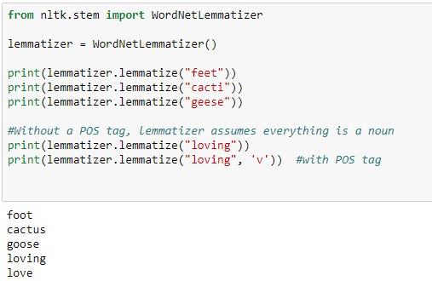
Lemmatization
Lemmatization uses vocabulary list and morphological analysis (POS of a word) to get the root word.
Form | Stem
saw | see ( if token is verb)
saw | saw (if token is noun)
Context taken into account
i
Lemmatization uses WordNet database which has English words linked together by their semantic relationships
Notes:
Trainer Notes:
1. Demo lemmatization in Jupyter

Slide 18
POS Tagging
POS tagging marks words in the corpus to a corresponding part of a speech tag based on its context and definition.
NOUN
VERB
ARTICLE
ADJECTIVE
Alice
wrote
a
program
POS tags used in NLTK
NNP proper noun, singular ‘Alice’
NN noun, singular 'desk’
RB adverb very, silently,
VBD verb, past tense took
JJ adjective ‘large’
VBZ verb, 3rd person sing. present takes
Notes:
Trainer Notes:
1. Explain various POS tags

Slide 19
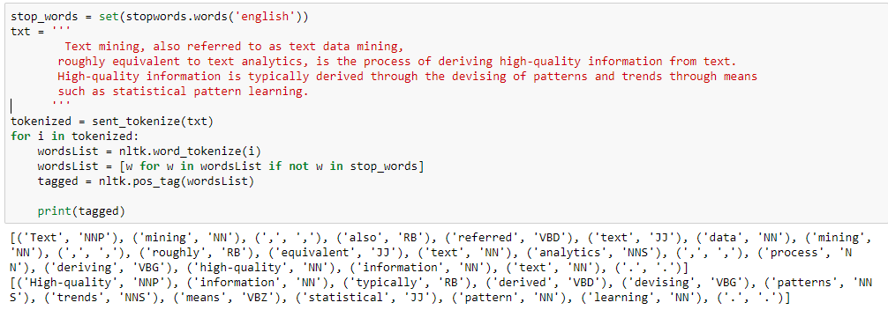
POS Tagging (Contd.)
POS Tags are useful for lemmatization, in building NERs and extracting relations between words
Notes:
Trainer Notes:
1. Demo POS tagging in Jupyter

Slide 20
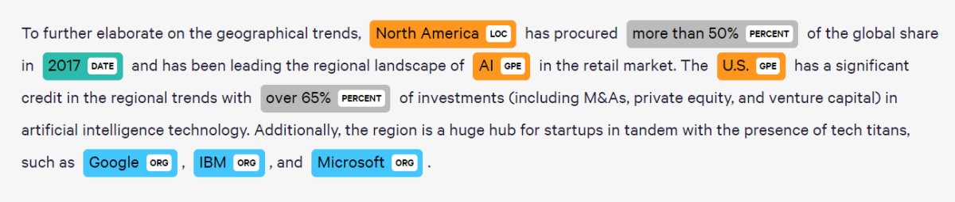
Named Entity Recognition (NER)
NER seeks to extract a real-world entity from the text and sort it into pre-defined categories such as the names of persons, organizations, locations, etc.
Notes:
Trainer Notes:
1. Explain the need for NER

Slide 21
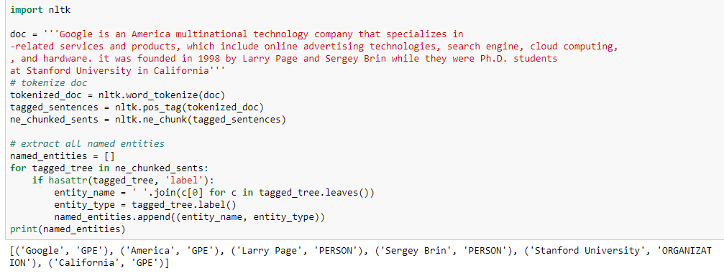
Named Entity Recognition (NER) (Contd.)
Notes:
Trainer Notes:
1. Demo NER technique in Jupyter

Slide 22
NLP Process Workflow
TOKENIZATION
Split text into pieces (tokens), remove punctuation.
STOPWORD REMOVAL
Remove commonly used words (Such as 'the’)
which are not relevant to analysis.
STEMMING AND LEMMATIZATION
Reduce words to base form to be
analyzed as a single item.
P.O.S TAGGING
Tag words to be part of speech (Such as verb, noun)
based on definition and context.
INFORMATION RETRIEVAL
Extracting relevant information from source
Notes:
Trainer Notes:
1. Explain the NLP process workflow

Slide 23
Assisted Practice
Text Extraction and Pre-processing
Duration: 15 mins.
Problem Statement: The Brown University Standard Corpus of Present-Day American English (Brown Corpus) was compiled in the 1960s as a general corpus in the field of corpus linguistics. It contains 500 samples of English-language text, totalling roughly one million words, compiled from works published in the United States in 1961.
You are required to work on the subset: ca10 document.
Objective:
Implement different types of tokenizers
Perform stemming and lemmatization
Evaluate POS tags for the tokens
Remove the stop words and apply NER
Access: Click on the Labs tab on the left side panel of the LMS. Copy or note the username and password that are generated. Click on the Launch Lab button. On the page that appears, enter the username and password in the respective fields, and click Login.
Notes:
Trainer Notes:
1. Perform the above demo in python by using brown_corpus_ca10 file and explain the functioning of each step
2. Also, ask the learner to perform the demo simultaneously on their system

Slide 24
Unassisted Practice
Text Extraction and Pre-processing
Duration: 20 mins.
Problem Statement: The wiki corpus contains the full text of Wikipedia, and it contains 1.9 billion words in more than 4.4 million articles. You are provided with a subset of the same.
Objective:
Implement different types of tokenizers
Perform stemming and lemmatization
Evaluate POS tags for the tokens
Remove the stop words and print NER words
Access: Click on the Labs tab on the left side panel of the LMS. Copy or note the username and password that are generated. Click on the Launch Lab button. On the page that appears, enter the username and password in the respective fields, and click Login.
Notes:
Trainer Notes: Explain the following:
1. Ask the learners to perform the above demo by using the wiki_corpus file (in class) and help them, if needed.

Slide 25
Step 1: Data Import and Tokenization
iris = datasets.load_iris()
X = iris.data
y = iris.target
Code
import nltk
with open('wiki_corpus.txt', 'r') as myfile:
data=myfile.read().replace('\n', '')
for i, line in enumerate(data.split('\n')):
if i > 10: # Lets take a look at the first 10 ads.
break
print(str(i) + ':\t' + line)
iris = datasets.load_iris()
X = iris.data
y = iris.target
from nltk import sent_tokenize, word_tokenize
sent_tokenize(data)
for sent in sent_tokenize(data):
print(word_tokenize(sent))

Slide 26
Step 2: Stemming and Lemmatization
Code
single_tokenized_lowered = list(map(str.lower, word_tokenize(data)))
from nltk.stem import PorterStemmer
porter = PorterStemmer()
for word in single_tokenized_lowered :
print(porter.stem(word))
from nltk.stem import WordNetLemmatizer
wnl = WordNetLemmatizer()
for word in single_tokenized_lowered:
print(wnl.lemmatize(word))

Slide 27
Step 3: Evaluate POS Tags
Code
stop_words = set(stopwords.words('english'))
tokenized = sent_tokenize(data)
for i in tokenized:
wordsList = nltk.word_tokenize(i)
wordsList = [w for w in wordsList if not w in stop_words]
tagged = nltk.pos_tag(wordsList)
print(tagged)

Slide 28
Step 4: Remove Stop Words and NER
Code
def extract_entity_names(t):
entity_names = []
if hasattr(t, 'label') and t.label:
if t.label() == 'NE':
entity_names.append(' '.join([child[0] for child in t]))
else:
for child in t:
entity_names.extend(extract_entity_names(child))
return entity_names

Slide 29
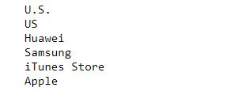
Step 4: Remove Stop Words and NER (Contd.)
Code
with open('wiki_corpus.txt', 'r') as f:
for line in f:
sentences = nltk.sent_tokenize(line)
tokenized_sentences = [nltk.word_tokenize(sentence) for sentence in sentences]
tagged_sentences = [nltk.pos_tag(sentence) for sentence in tokenized_sentences]
chunked_sentences = nltk.ne_chunk_sents(tagged_sentences, binary=True)
entities = []
for tree in chunked_sentences:
entities.extend(extract_entity_names(tree))
list_set = set(entities)
unique_list = (list(list_set))
for x in unique_list:
print (x)

Slide 30
Text Mining
Topic 4: Structuring Sentences

Slide 31
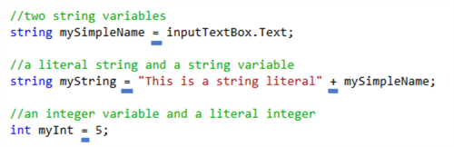
Syntax
Syntax is the grammatical structure of the sentences.
Can be interpreted as syntax similar to the ones you use while writing codes.

Slide 32
Phrase Structure Rules
Phrase structure rules are rewrite rules that generate phrase structure.
S -> NP VP
VP -> V(NP) (PP)
NP -> (Det) N
PP -> P NP
Notes:
Trainer Notes:
1. Explain the Phase structure rules

Slide 33
Syntax Tree Parsing
A tree representation of syntactic structure of formulation of sentences or strings.
Consider the example: “The factory employs 12.8 percent of Bradford County.”
A tree is produced that might help you understand that the subject of the sentence. “the factory”
The predicate is “employs”, and the target is “12.8 percent” which in turn is modified by “Bradford County.”
Syntax parses are often a first step toward deep information extraction or semantic understanding of text.
Syntax Parsing the above statement:
Notes:
Trainer Notes:
1. Give more examples

Slide 34
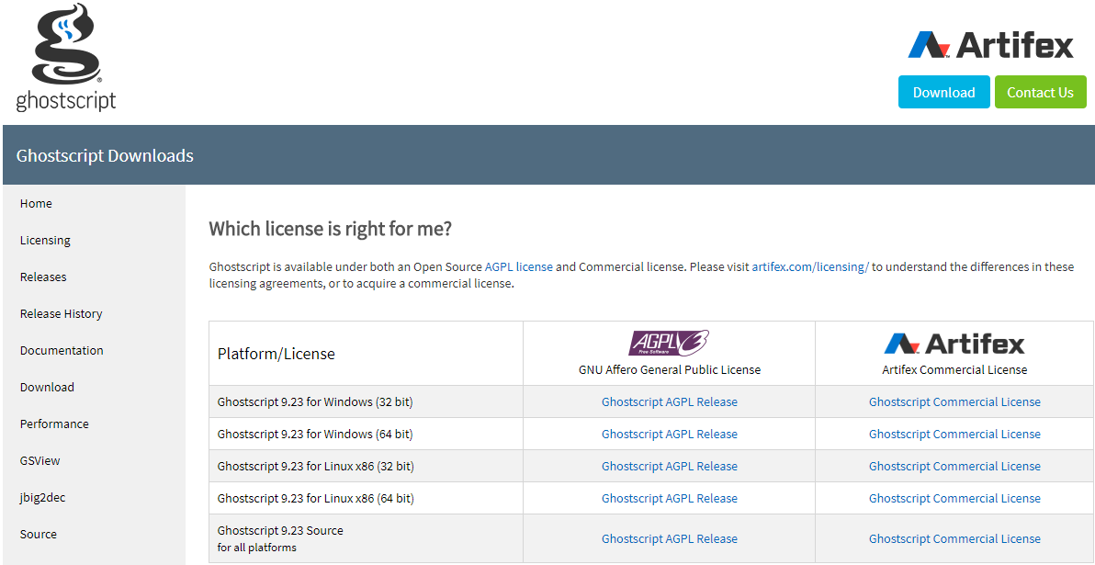
Rendering Syntax Trees
In order to render syntax trees in your notebook, you need to install ghostscript (a rendering engine) from the link: https://ghostscript.com/download/gsdnld.html
Download the corresponding .exe file based on your system configuration
Notes:
Trainer Notes:
1. Ask learners to install ghostscript (set-up instructions are provided in the next slides)

Slide 35
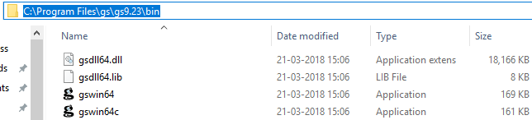
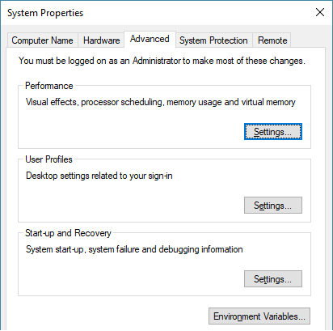
Setting Up Environment Variables
Once you have downloaded and installed the file:
-> go to the folder where it is installed -> open the bin folder -> add the path to the bin folder in your environment variables

Slide 36
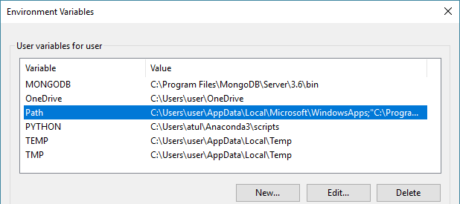
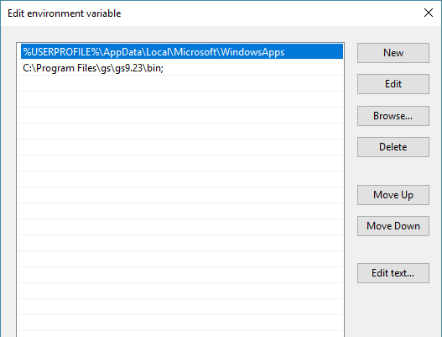
Setting Up Environment Variables (Contd.)

Slide 37
Setting Up Path Variable
Now, you will have to modify the path of the environment variable.
Code
import os
path_to_gs = "C:\\Program Files\\gs\\gs9.23\\bin“
os.environ['PATH']+=os.pathsep + path_to_gs #modifying environment variable
Now, let’s start with analyzing sentence structure.

Slide 38
Chunking and Chunk Parsing
Chunking
Segmentation: identifying tokens
Labeling: identifying the correct tag
Chunk Parsing
Segmentation: identifying strings of tokens
Labeling: identifying the correct chunk type
Notes:
Trainer Notes:
1. Explain Chunk Parsing in detail with example

Slide 39
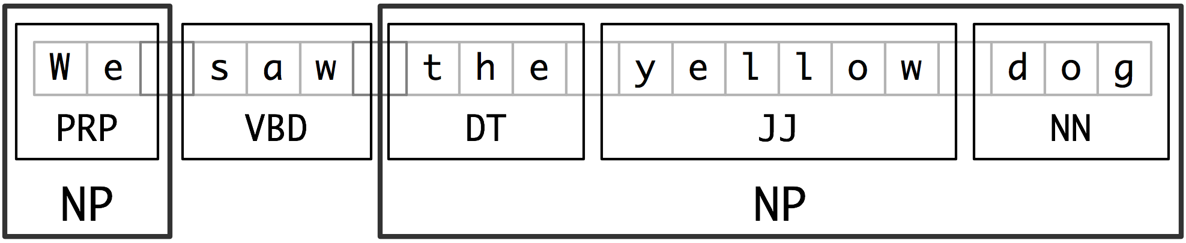
Chunking: An Example
Source: nltk.org
You can see here: Yellow(adjective), dog(noun), and the determiner are chunked together into a noun phrase (NP)

Slide 40
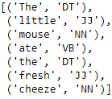
Chunking Using Python
Let’s consider the sentence below:
sent = "The little mouse ate the fresh cheese"
Code
sent_tokens = nltk.pos_tag(word_tokenize(sent))
sent_tokens

Slide 41
NP Chunk and Parser
You will now create grammar from a noun phrase and will mention the tags you want in your chunk phrase within { }. Here you have created a regular expression matching the string.
Code
grammar_np = r"NP: {<DT>?<JJ>*<NN>}"
You will now have to parse the chunk. Therefore, you will create a chunk parser and pass your noun phrase string to it.
Code
chunk_parser = nltk.RegexpParser(grammar_np)
Notes:
Trainer Notes:
1. Ask learners to demo the above code in Jupyter

Slide 42

NP Chunk and Parser (Contd.)
The parser is now ready. You will use the parse ( ) within your chunk parser to parse your sentence.
Code
chunk_result = chunk_parser.parse(sent_tokens)
chunk_result
The tokens that matched our regular expressions are chunked together into noun phrases(NP)
Notes:
Trainer Notes:
1. Ask learners to demo the above code in Jupyter

Slide 43
VP Chunk and Parser
Create a verb phrase chunk using regular expressions.
Code
grammar_vp = r"vp: {<PRP>?<VB|VBD|VBZ|VBG>*<RB|RBR>?}"
You’ll now create another chunk_parser and pass the verb phrase string to it.
Code
chunk_parser2 = nltk.RegexpParser(grammar_vp)
Notes:
Trainer Notes:
1. Ask learners to demo the above code in Jupyter

Slide 44
VP Chunk and Parser (Contd.)
Create another sentence and tokenize it. Add POS tags to it.
Code
sent3 = "She is walking quickly to the mall“
sent_tokens3 = nltk.pos_tag(word_tokenize(sent3))
Now, use the new verb phrase parser to parse the tokens and run the results.
Code
chunk_result3 = chunk_parser2.parse(sent_tokens3)
chunk_result3
Notes:
Trainer Notes:
1. Ask learners to demo the above code in Jupyter

Slide 45

VP Chunk and Parser (Contd.)
A verb parser where a pronoun followed by two verbs and an adverb are chunked together into a verb phrase

Slide 46
Chinking
Chinking is the process of removing a sequence of tokens from a chunk
If the sequence of tokens spans an entire chunk, then the whole chunk is removed
If the sequence of tokens appears in the middle of the chunk, these tokens are removed, leaving two chunks where there was only one before
If the sequence is at the beginning or end of the chunk, these tokens are removed, and a smaller chunk remains
Notes:
Trainer Notes:
1. Explain Chinking process

Slide 47
Create Chink Grammar
Consider you create a chinking grammar string containing three things:
Chunk name
The regular expression sequence of a chunk
The regular expression sequence of your chink
Code
chink_grammar = r"""
chk_name: #chunk name
{<PRP>?<VB|VBD|VBZ|VBG>*<RB|RBR>?} #chunk regex sequence
}<RB>+{ #chink regex sequence - adverb
"""
Inside chinking block with } {, you have created one or more adverbs

Slide 48
Create Chink Parser
You will now create a parser from nltk.RegexpParser and pass the chink_grammar to it.
Code
chink_parser = nltk.RegexpParser(chink_grammar)
Now, use the new chink parser to parse the tokens (sent3) and run the results.
Code
chink_parser.parse(sent_tokens3)

Slide 49

Create Chink Parser ( Contd.)
While comparing the syntax tree of chink parser with that of the original chunk, you can see that the token quickly (adverb) is chinked out of the chunk

Slide 50
Text Mining
Topic 5: Context Free Grammar (CFG)

Slide 51
CFG
A context-free grammar is a 4-tuple (∑, NT, R, S), where:
∑ is an alphabet (each character in ∑ is called terminal)
NT is a set (each element in NT is called nonterminal)
R, the set of rules, is a subset of NT × (∑ ∪ NT)*
S, the start symbol, is one of the symbols in NT
Generates a language L by capturing constituency and ordering
.
Notes:
Trainer Notes:
1. Explain CFG in detail

Slide 52






CFG: Example
S -> NP VP
NP -> Det Nominal
Nominal -> Noun
VP -> Verb
Det -> a
Noun -> flight

Slide 53
Implementing CFG
Consider the string below, where you have certain rules:
Code
CFG_grammar = nltk.CFG.fromstring("""
S -> NP VP
VP -> V N
V -> "saw"|"met"
NP -> "John"|"Jim"
N -> "dog"|"cat"
""")
It should have a noun phrase followed by a verb phrase. A verb phrase is a verb followed by a noun. A verb can either be saw or met. Noun phrase can either be John or Jim, and a noun can either be a dog or a cat
Notes:
Trainer Notes:
1. Ask learners to demo the code in Jupyter

Slide 54

Implementing CFG (Contd.)
Check the possible list of sentences that can be generated using the rules:
Code
for sentence in generate(CFG_grammar):
print(" ".join(sentence))
Notes:
Trainer Notes:
1. Ask learners to demo the code in Jupyter

Slide 55
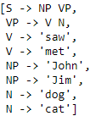
Implementing CFG (Contd.)
You can check the different rules of grammar for the sentence formation using the productions( ):
Code
CFG_grammar.productions()
Notes:
Trainer Notes:
1. Ask learners to demo the code in Jupyter

Slide 56
Assisted Practice
Structuring Sentences
Duration: 20 mins.
Problem Statement: ABC Company wants to perform text analysis for one of its dataset.
The dataset has been taken from Kaggle. (https://www.kaggle.com/crowdflower/twitter-airline-sentiment/home)
This dataset has tweets about six US Airlines along with their sentiments: positive, negative, and neutral. You are provided with this dataset named “Tweets.csv”. It has tweets in ‘text’ column and sentiments in “airline_sentiment” column.
Objective: Retrieve all tags starting from “@” in the entire dataset and save in a file called
“References.txt”. Extract all noun phrases from the dataset and save them in different lines in a file named “Noun Phrases for <airline_sentiment> Review .txt” (You can choose your own grammar for noun phrase).
Here <airline_sentiment> will have three different values: positive, negative, and neutral. Hence, three files will be created.
Access: Click on the Labs tab on the left side panel of the LMS. Copy or note the username and password that are generated. Click on the Launch Lab button. On the page that appears, enter the username and password in the respective fields, and click Login.
Notes:
Trainer Notes:
Perform the above demo in python by using the tweets.csv dataset from the LMS.
Ask the learners to perform the same on their system simultaneously.

Slide 57
Unassisted Practice
Structuring Sentences Duration: 15 mins.
Problem Statement: ABC Company wants to perform some text analysis and make visualization for one it’s dataset. The dataset has been taken from Kaggle. (https://www.kaggle.com/crowdflower/twitter-airline-sentiment/home). This is a dataset having tweets about six US Airlines along with their sentiments: positive, negative, and neutral. You are provided with this dataset named “Tweets.csv”. It has tweets in ‘text’ column and sentiments in ‘airline_sentiment’ column.
Objective: Extract all verb phrases from their dataset and save them in different lines in a file named “Verb Phrases for <airline_sentiment> Review .txt” (You can choose your own grammar for noun phrase). Here <airline_sentiment> will have three different values: positive , negative, and neutral. Hence, three files will be created. For each sentiment, make a well labeled pie chart showing the distribution of noun phrases and verb phrases of that sentiment from the data set. Use the files created above to get the frequencies.
Note: This practice is not graded. It is only intended for you to apply the knowledge you have gained to solve real-world problems.
Access: Click on the Labs tab on the left side panel of the LMS. Copy or note the username and password that are generated. Click on the Launch Lab button. On the page that appears, enter the username and password in the respective fields, and click Login.
Notes:
Trainer Notes:
1. Ask the learners to perform the above demo by importing the tweets.csv dataset (in class) and help them, if needed.

Slide 58
Step 01
Code
import pandas as pd
df=pd.read_csv('Tweets.csv')
df=df[['text','airline_sentiment']]
Notes:
Trainer Notes:
1. Ask learners to demo the code in Jupyter

Slide 59
Step 02
import nltk
def GetVerbPhrases(s):
try:
sentences = nltk.sent_tokenize(s)
sentences = [nltk.word_tokenize(sent) for sent in sentences]
sentences = [nltk.pos_tag(sent) for sent in sentences]
except:
return []
else:
grammar=r"VP:{<VB|VBD|VBG|VBZ|VBP|VBN>*<VB|VBD|VBG|VBZ|VBP|VBN><RB|RBR>*<RB|RBR>}"
cp = nltk.RegexpParser(grammar)
noun_phrases_list = [[' '.join(leaf[0] for leaf in tree.leaves())
for tree in cp.parse(sent).subtrees()
if tree.label()=='VP']
for sent in sentences]
return noun_phrases_list
Notes:
Trainer Notes:
1. Ask learners to demo the code in Jupyter

Slide 60
Step 03
Code
import itertools
for group,sub in df.groupby('airline_sentiment'):
verb_phrases=map(lambda x: GetVerbPhrases(x),sub['text'])
verb_phrases=list(itertools.chain.from_iterable(verb_phrases))
AllVerbPhrases=set(list(itertools.chain.from_iterable(verb_phrases)))
filename="Verb Phrases for "+str(group)+" Review .txt"
file=open(filename,'a')
for each in AllVerbPhrases:
file.write(each+"\n")
file.close()
Notes:
Trainer Notes:
1. Ask learners to demo the code in Jupyter

Slide 61
Step 04
#Plotting a pie chart
def PlotPieChart(sentiment):
noun_phrase_file="Noun Phrases for "+str(sentiment)+" Review .txt"
verb_phrase_file="Verb Phrases for "+str(sentiment)+" Review .txt"
noun_phrase_count=len(noun_phrase_file.split("\n"))
verb_phrase_count=len(verb_phrase_file.split("\n"))
counts=[noun_phrase_count,verb_phrase_count]
labels=['Noun Phrases','Verb Phrases']
import matplotlib.pyplot as plt
%matplotlib inline
plt.figure(figsize=(5,5))
plt.pie(counts,labels=labels)
plt.title("Phrases Distribution for "+str(sentiment)+" Review.")
plt.show()
for each in df['airline_sentiment'].unique():
PlotPieChart(each)

Slide 62
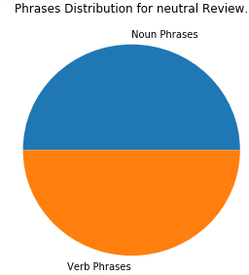
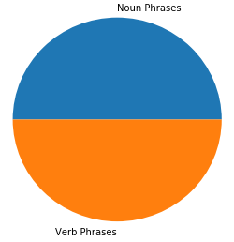
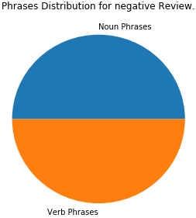
Step 04 (Contd.)
Phrases Distribution for neutral review
Phrases Distribution for positive review
Phrases Distribution for negative review
Notes:
Trainer Notes:
1. Explain the diagram

Slide 63
Now, you are able to:
Explain text mining
Execute text processing tasks

Slide 64

© Simplilearn. All rights reserved.

Slide 65
Which of the following describes the file representation given below?
[the/DT little/JJ cat/NN] sat/VBD on/IN [the/DT mat/NN]
1
Chunked Text
Tagged Text
Chunked and Tagged Text
Chinked Text

Slide 66
Which of the following describes the file representation given below?
[the/DT little/JJ cat/NN] sat/VBD on/IN [the/DT mat/NN]
1
Chunked Text
Tagged Text
Chunked and Tagged Text
Chinked Text
c. Chunked and Tagged Text
The above text is segregated as well as POS tagged.

Slide 67
Tokenization, is a way to:
2
Find the grammar of the text
Split text data into words, phrases, and idioms
Analyze the sentence structure
Find ambiguities

Slide 68
Tokenization, is a way to:
1
Find the grammar of the text
Split text data into words, phrases, and idioms
Analyze the sentence structure
Find ambiguities
b. Split text data into words, phrases, and idioms
Splitting text data into words, phrases, and idioms is known as tokenization and each individual word is known as a token.

Slide 69
Lesson-End Project
Duration: 10 mins.
Problem Statement: Consider the FIFAWORLDCUP2018.txt file.
Objective: 1. Write separate Python functions that accept a string, a number ‘n’, and returns the following:
N most frequent nouns (Take function name as “GetNMostFrequentNouns”)
N most frequent verbs (Take function name as “GetNMostFrequentVerbs”)
N most frequent delimiters (Take function name as “GetNMostFrequentDelimiters”)
N most frequent prepositions (Take function name as “GetNMostFrequentPrepositions”)
Run all the functions on the file “FIFAWorldCup2018.txt” and print the results.
2. Write a Python function that accepts a string and prints the first sentence in the string along with its syntax tree. Take function name as “PrintSyntaxTree”
Run this function on the file “FIFAWorldCup2018.txt”
Notes:
Trainer Notes: Explain the project to the learners and instruct them to perform it after the lesson.

Slide 70
Lesson-End Project
Duration: 10 mins.
Objective: 3. Write a Python function that accepts and returns a string using regular expressions:
Text from the string after removing all the punctuations (Take function name as “TextAfterRemovingPunctuations”)
Text from the string after removing all the numbers/digits (Take function name as “TextAfterRemovingDigits”)
All the words that begin with the capital letter (Take function name as “AllCapitalizedWordsFromText”)
All the emails from the string (Take function name as “AllEmailsFromText”)
Run all the above functions on the file “FIFAWorldCup2018.txt” and print the results.
4. Write Python functions that accept a string as an input and return the following chunks:
Phrases having proper nouns followed by verbs (Take function name as “ChunkingVer1”)
Verb phrases having verbs followed by adjectives (Take function name as “ChunkingVer2”)
Noun phrases having determiners followed by nouns (Take function name as “ChunkingVer3”)
Verb phrases having verbs followed by adverbs (Take function name as “ChunkingVer4”)
Phrases having delimiter, adjectives, and nouns in the respective order. (Take function name as “ChunkingVer5”)
Noun phrases having nouns and adjectives, terminated with nouns. (Take function name as “ChunkingVer5”)
Run all the functions for the first sentence in the file “FIFAWorldCup2018.txt” and print the results.
Notes:
Trainer Notes: Explain the project to the learners and instruct them to perform it after the lesson.

Slide 71
Lesson-End Project
Duration: 10 mins.
Objective: Make a content-free grammar having the following rules:
Noun phrases are followed by verb phrases
Verb phrase can have:
Verb and noun phrases
Verb, noun phrases, and preposition phrases
Noun phrases can have:
Delimiters followed by noun
Preposition phrase has a preposition followed by a noun phrase
The delimiters, verbs, prepositions, and nouns for the grammar should be the 2 most frequent words of each type from “FIFAWorldCup2018.txt”. Generate the CFG for “FIFAWorldCup2018.txt” file and save them in a file named “CFG.txt”
Access: Click the Labs tab in the left side panel of the LMS. Copy or note the username and password that are generated. Click the Launch Lab button. On the page that appears, enter the username and password in the respective fields and click Login.
Notes:
Trainer Notes: Explain the project to the learners and instruct them to perform it after the lesson.

Slide 72
© Simplilearn. All rights reserved.

